Slide 1
WICCI (WELLNESS & WELLBEING COUNCIL, GUJARAT)
WOMEN´S INDIAN CHAMBER OF COMMERCE AND INDUSTRY
www.wicci.in

Slide 2
Council Vision &Mission
VISION:-
TO HELP EACH OTHER & GROW TOGETHER PERSONALLY &
PROFESSIONALLY.
MISSION:-
TO CREATE AWARENESS ABOUT PHYSICAL & MENTAL HEALTH &
TO SPREAD HEALTHY & FIT LIFESTYLE

Slide 3
Welcoming
Council Members to
WICCI
President, Vice President
and 20+ Nominated Council Members

Slide 4
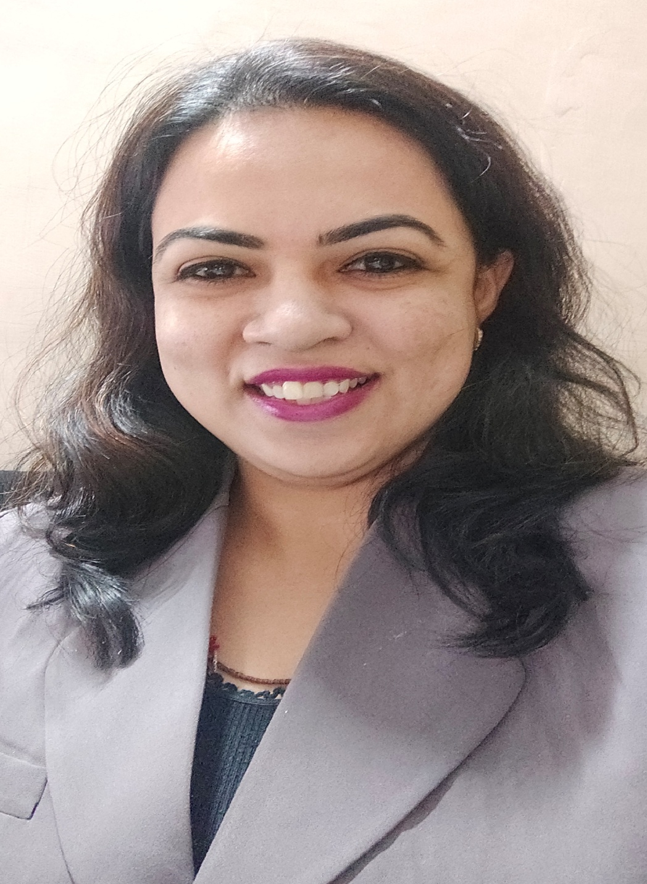
PRERNA VASWANI – STATE PRESIDENT
WICCI WELLNESS & WELLBEING COUNCIL GUJARAT
BIO :-
Name : PRERNA VASWANI
Email: prernavaswaniwicci@gmail.com
Qualification: B.Com, DBM with E-commerce & PGDCRM (Symbiosis)
Work experience : Founder of PRERNA – Spreading Inspiration /Awarded as Video Blogger of the Year / Working as BDM in one of Facility Management Service Provider Co./ Total Job Exp. of 17yrs+/ Online Udemy Certified Yoga Instructor / Awarded & Crowned as Inspiring Gem of India- Queen in the Making-2019 / Member of Giving Back Foundation NGO

Slide 5
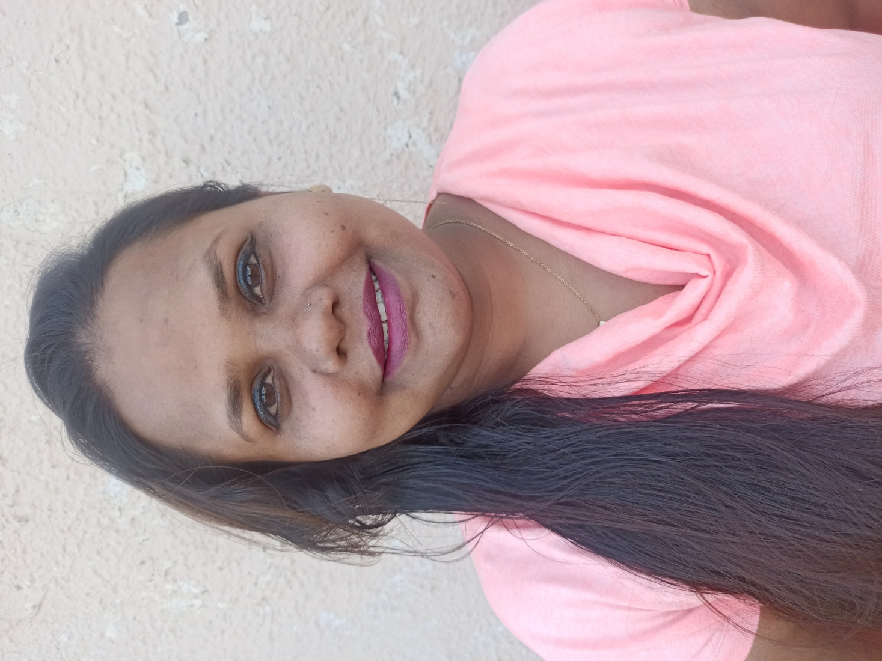
NIKKI PEREIRA- STATE VICE PRESIDENT
WICCI WELLNESS & WELLBEING COUNCIL GUJARAT
BIO :-
Name - Nikki Pereira
Email ID- nkkpereira@gmail.com
Qualification – DCA, DEEP (Dance Education Elite program) Functional Strength Training (FSSA) Crush fitness India Trainer
Work experience [13+ Years] - 7 years in Stock market as (Trainer & On field marketing manager)
3.5 years in BPO (CSR, Quality analyst & TL) . 2016 till 2020 as Administration, Dance & Fitness Trainer. 2020 Sept. started Own classes as Nikki's Dance & Fitness till date(Virtual & Freelance for Dance, Fitness, Wedding events, Corporate events and more)

Slide 6
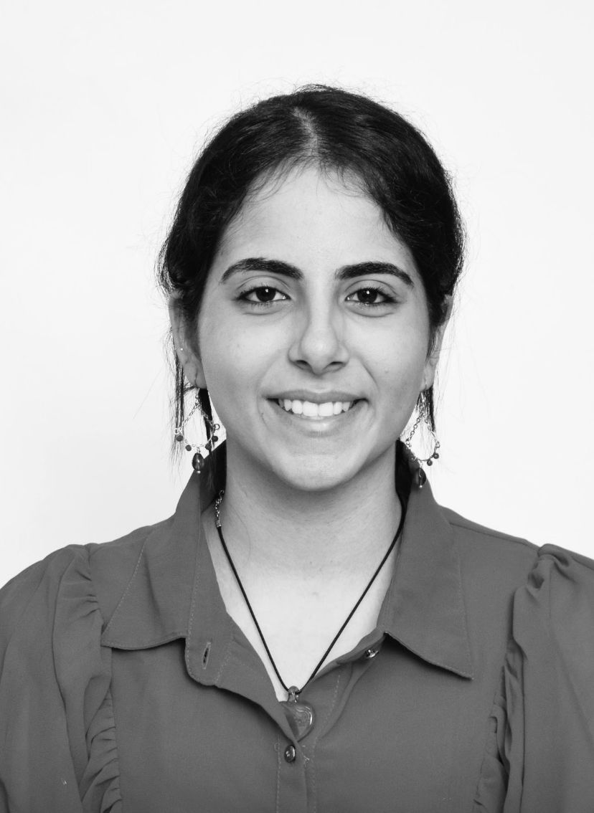
ANUSHA MALHOTRA - COUNCIL MEMBER
WICCI WELLNESS & WELLBEING COUNCIL GUJARAT
BIO :-
Name: ANUSHA MALHOTRA
Email: anhotra@gmail.com
Qualification: Final year Journalism student at Lady Shri Ram College for Women, New Delhi
Work Experience: Founder of The Zyada Mat Bolo Collective, a stigma-breaking NGO, leading a team of 35+ professionals. She has corporate experience as a content writer, content creator, social media manager, and influencer for brands such as IIM Calcutta, ITC Hotels, Radisson Hotels, Beanly, etc. and is also a social worker & educator.

Slide 7
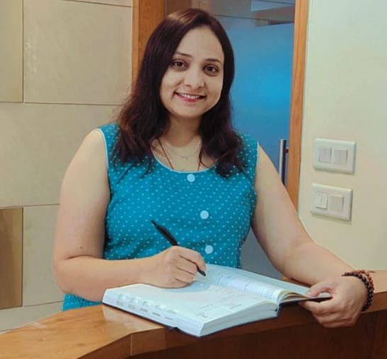
HEMADRI JOSHI UPADHYAY - COUNCIL MEMBER
WICCI WELLNESS & WELLBEING COUNCIL GUJARAT
BIO :-
Name: HEMADRI JOSHI UPADHYAY
Email: joshi.hemadri@gmail.com
Qualification: MBA - HR
Work Experience: She practices Spiritual Services - Astrologer, Healer, Vastu Consultant, Tarot card Reader & Medical Yog Trainer. She has 8 years pf corporate experience as well as Skill Trainer.

Slide 8
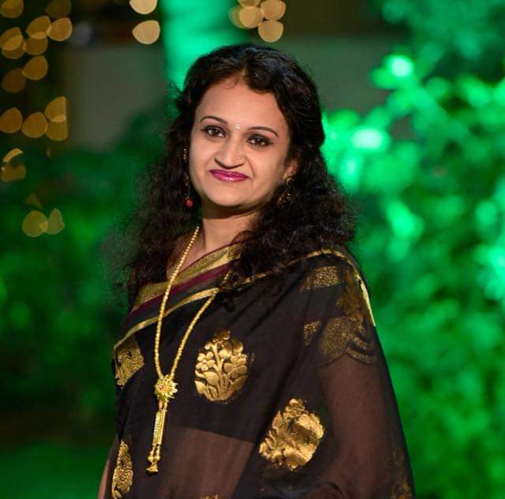
VISHAKHA MEHTA- COUNCIL MEMBER
WICCI WELLNESS & WELLBEING COUNCIL GUJARAT
BIO :-
Name: VISHAKHA MEHTA
Email: vishakhamehta1982@gmail.com
Qualification: B.com , B.ED (Music) Bharatnatyam Dance in B.A ,Tarot card Reader & Teacher, Reiki Master, Crystal Healer , Vaastu Consultant
Work Experience: 18 years in Dance and Music

Slide 9
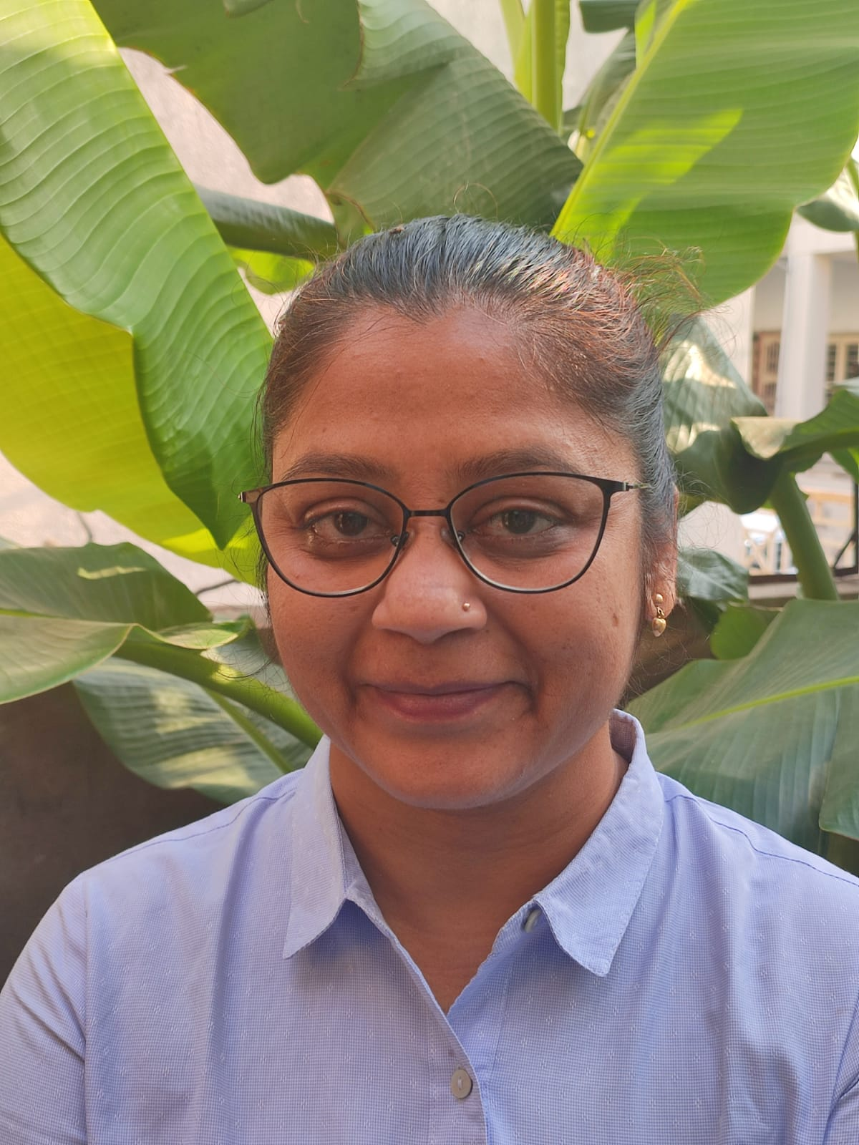
PARUL SHAH- COUNCIL MEMBER
WICCI WELLNESS & WELLBEING COUNCIL GUJARAT
BIO :-
Name: Parul Shah
Email: parul.shah76ps@gmail.com
Qualification: B. Sc, CYS, NDDY,YPV Healing
Work Experience: 20 yrs Gynaec Pharma marketing,
2 years Yoga & Naturopathy 4 yrs & now-YPV Healer, Trainer & Counselor Solution and Training of all Physical, Emotional, Psychological, Relationship, Weight, Prosperity & Life related issues.

Slide 10
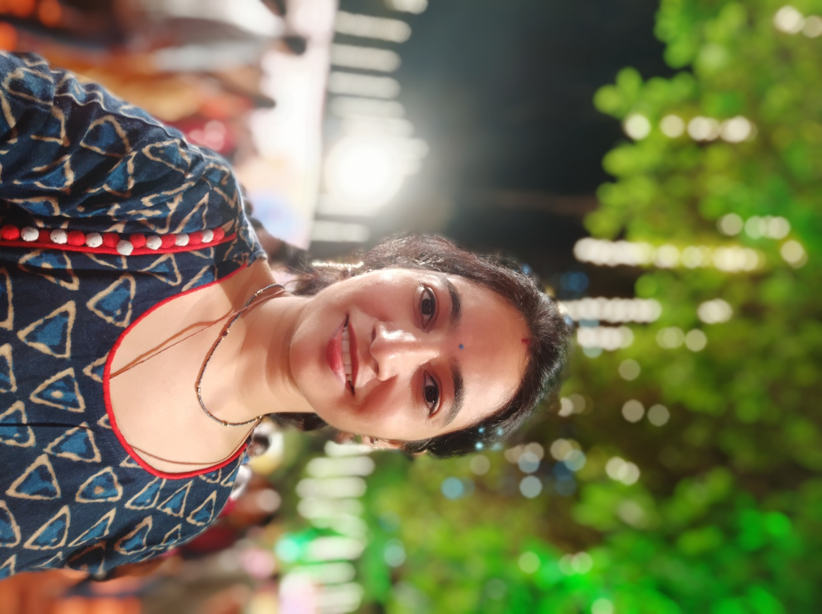
DR. SHWETABA JADEJA - COUNCIL MEMBER
WICCI WELLNESS & WELLBEING COUNCIL GUJARAT
BIO :-
Name:Dr.Shwetaba Jadeja
Email:jhala.shwetaba@gmail.com
Qualification:BAMS Ayurveda consultant, Garbhasanskar Counsellor, Yoga therapist, Access facelift and Access bars practitioner, EFT practitioner, Bach flower practitioner
My brand name "Veda for Wellness"- Suvarnaprashan
Work Experience:14 years

Slide 11
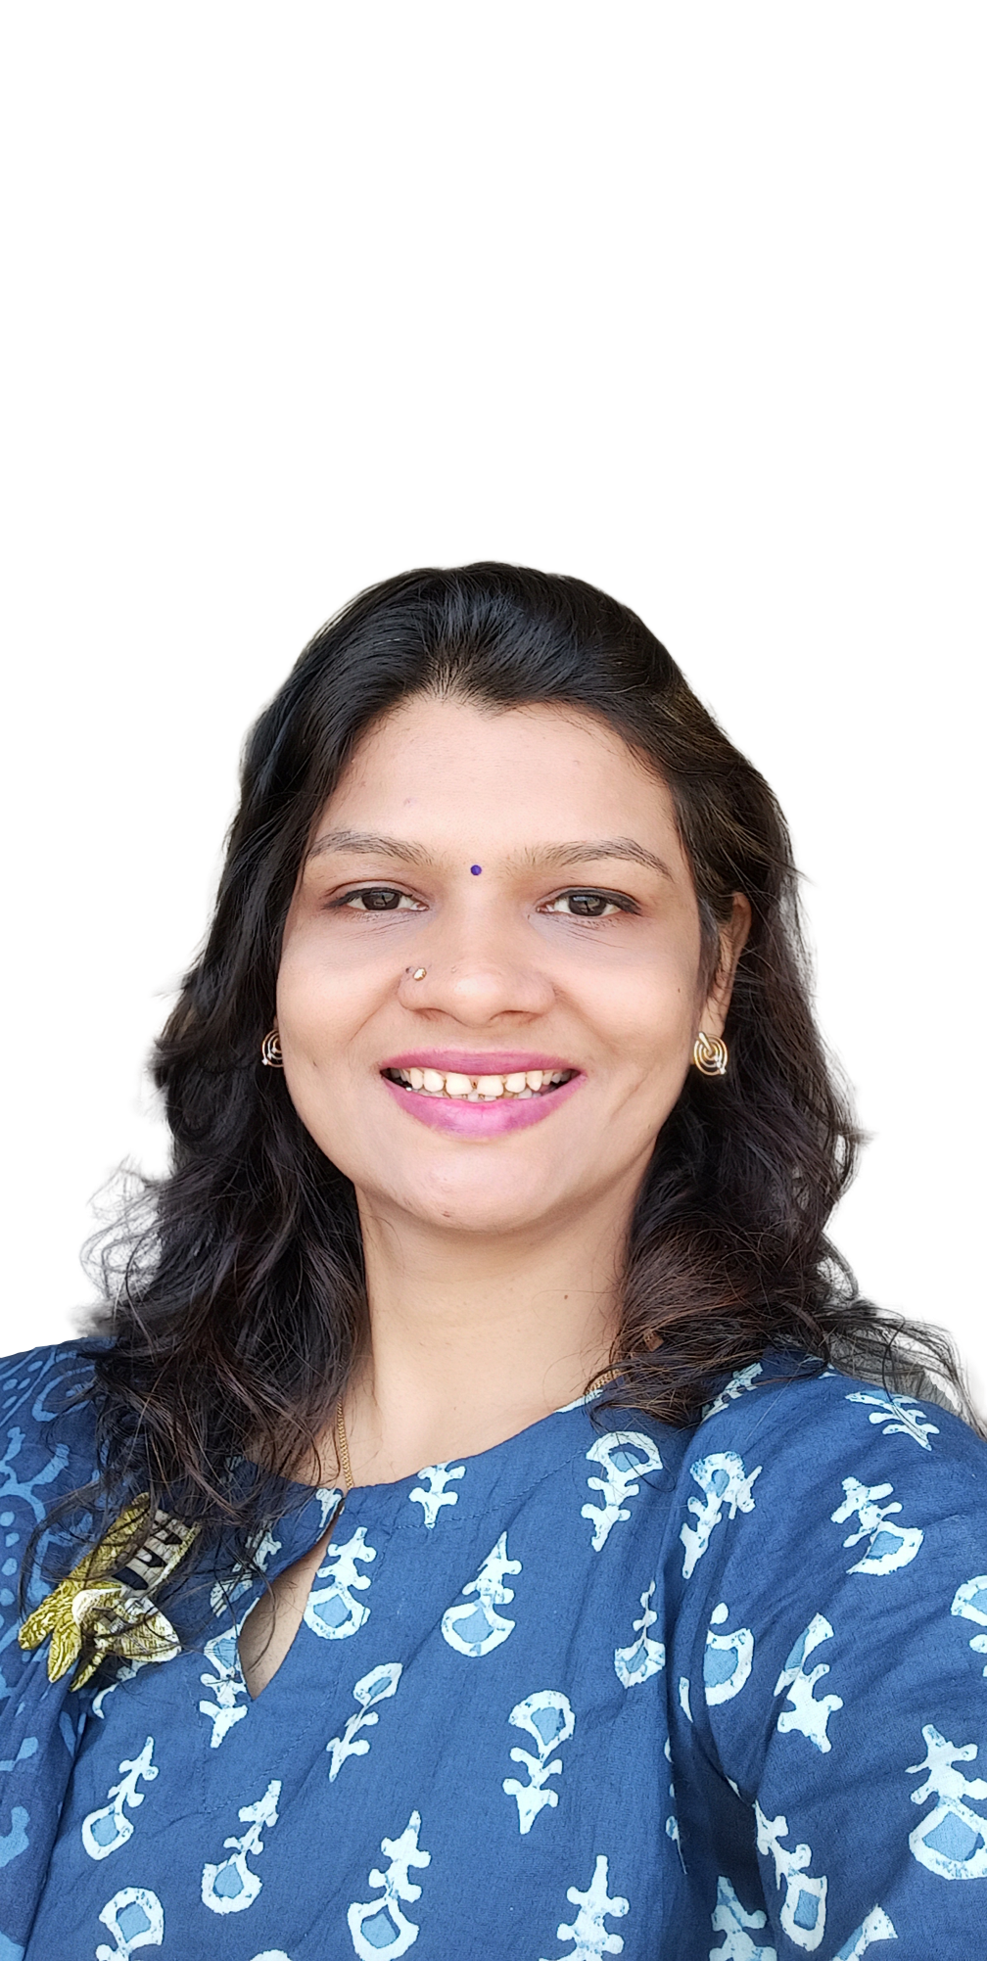
DR. MEGHAVI SHAH - COUNCIL MEMBER
WICCI WELLNESS & WELLBEING COUNCIL GUJARAT
BIO :-
Name: Dr Meghavi Shah
Email: drmeghavishah@gmail.com
Qualification: BAMS Ayurveda and Panchkarma specialist, Yoga instructor, Access bars facilitator, Clinical Hypnotherapist, Access facelift practitioner
Bach flower facilitator, EFT practitioner
Work Experience: 14yrs
Founder of WE-DIVINE Healing center, makes hair & skin care products. Practicing & conducting workshops with different healing modality

Slide 12
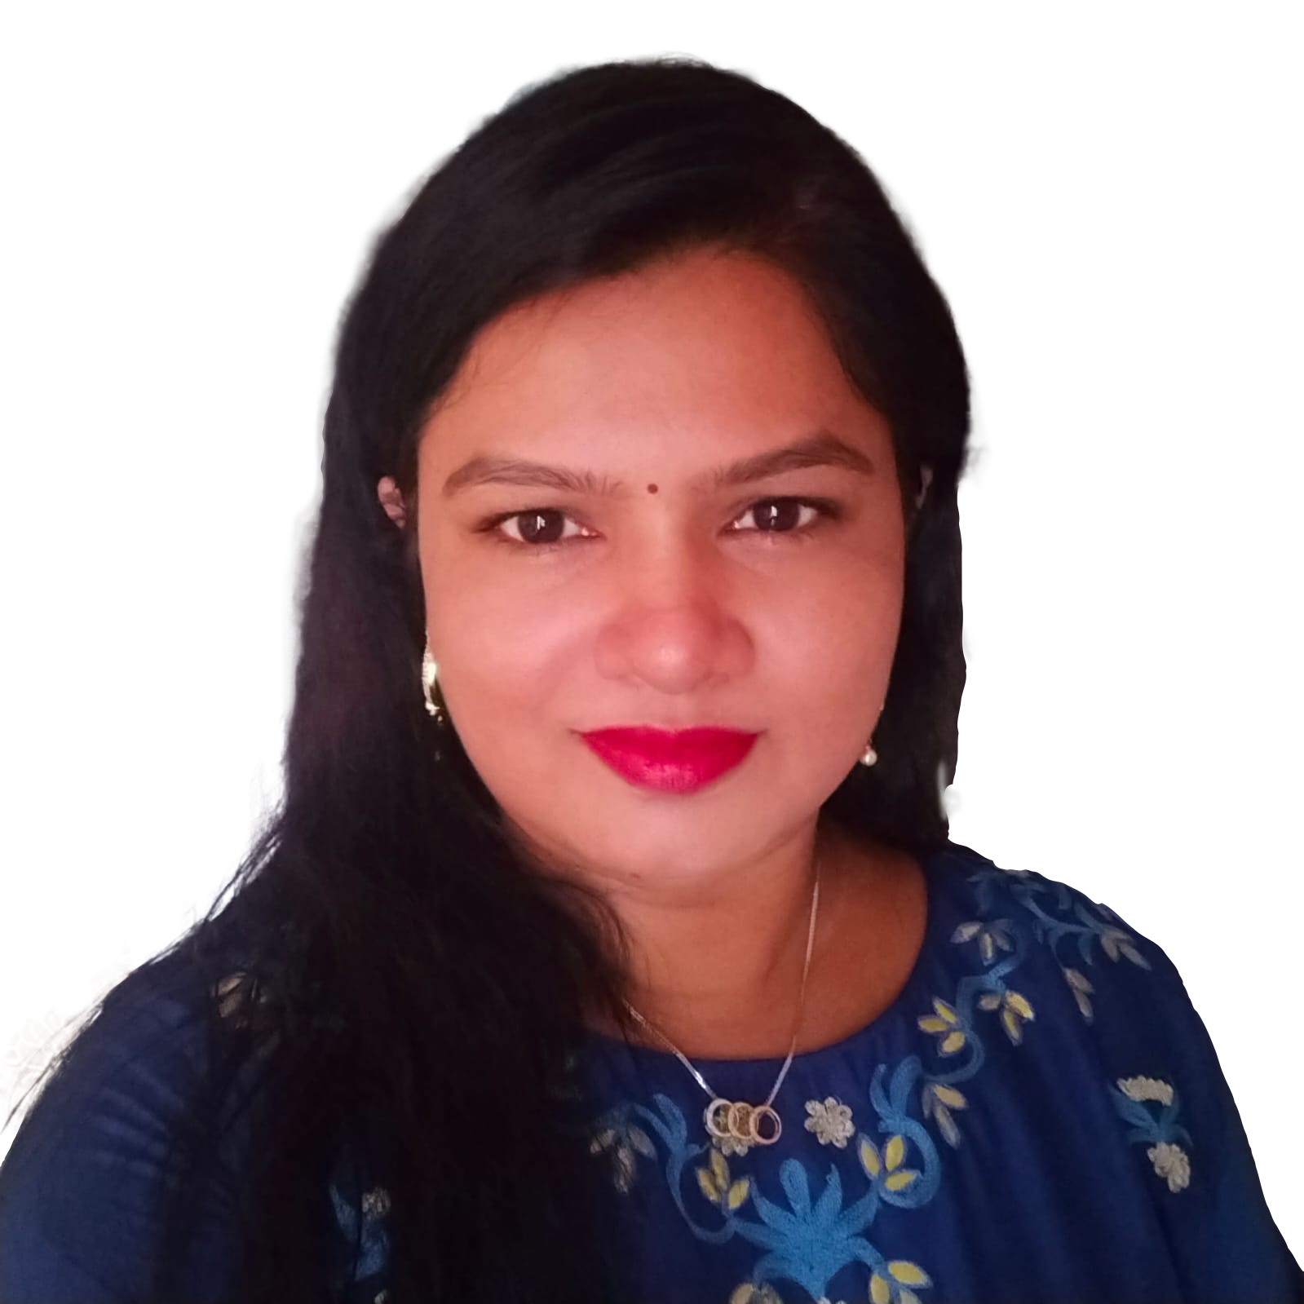
BELA JOGANI - COUNCIL MEMBER
WICCI WELLNESS & WELLBEING COUNCIL GUJARAT
BIO :-
Name: Bela Jogani
Email: pari1983333@gmail.com
Qualification: Yoga instructor & Manufacturing hair n skin care products
Work Experience: 7 years

Slide 13
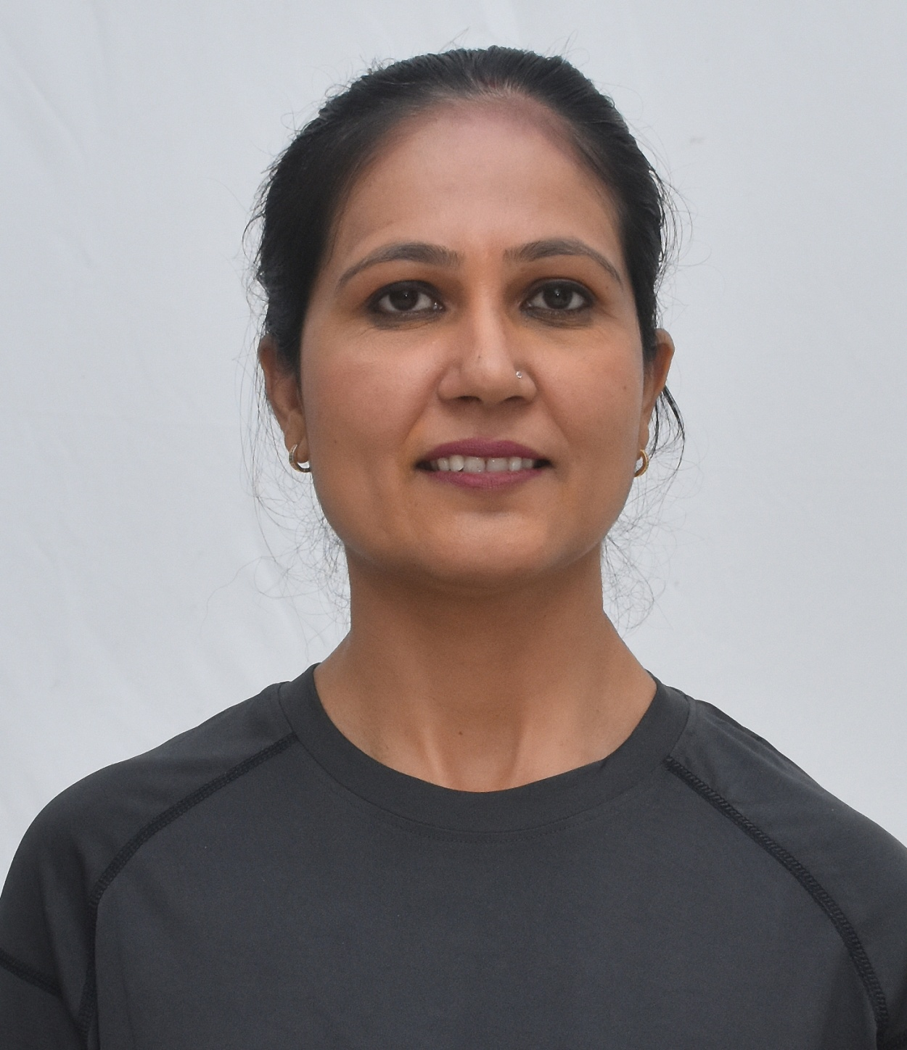
JIGISHA JAGDISH VALA - COUNCIL MEMBER
WICCI WELLNESS & WELLBEING COUNCIL GUJARAT
BIO :-
Name : Jigisha Jagdish Vala
E mail : yogvalaacedemy@gmail.com
Qualifications: M.A. in Yoga
Work Experience: Founder : Yogvala Fitness Acedemy than 5 yrs+ Providing services like Weight loss/Gain Challenge, chiropractic, Therapeutic yoga, Acro yoga, Advance yoga, Yoga boot camp, Yoga trip, Sathkarma, Parental yoga and Many More

Slide 14
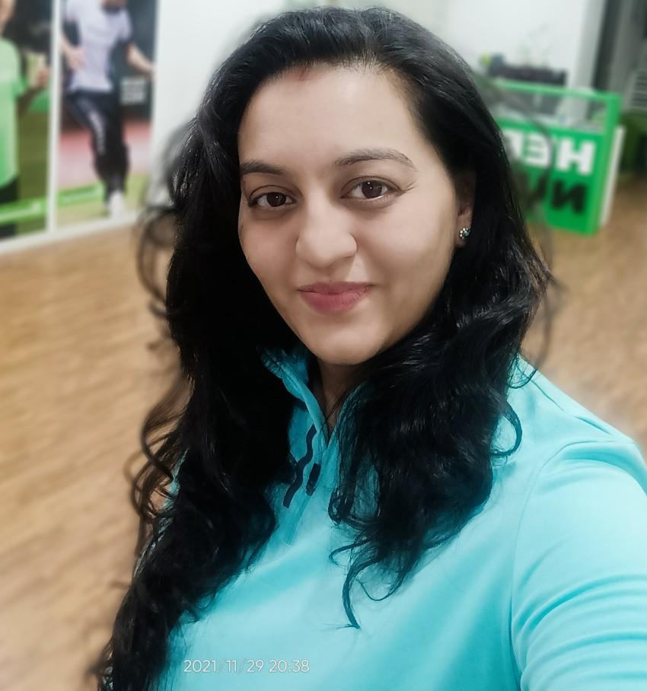
SWETA GUPTA - COUNCIL MEMBER
WICCI WELLNESS & WELLBEING COUNCIL GUJARAT
BIO :-
Name: Sweta Gupta
Email: shwetasharma292717@gmail.com
Qualification: MBA marketing sp. Biotechnology, Fitness coach
Work Experience: Partner @fitavenue , a premium fitness studio. We are into body transformations and weight management.

Slide 15
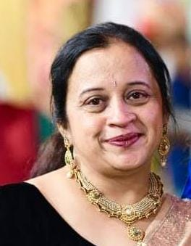
DR. ANITA SHARMA - COUNCIL MEMBER
WICCI WELLNESS & WELLBEING COUNCIL GUJARAT
BIO :-
Name: Dr. Anita Sharma
Email:bigdreamsworld23@gmail.com
Qualification: B.H.M.S, Certified in various healing modalities like Body Mind Programming , NLP, Life Coach, EFT, Redikal Healing , Chakra Healing , Hypnosis , Graphology etc.
Work Experience: 28 years , Worked with patients especially students & their parents including professionals, entrepreneurs & various corporate houses educational institutes and Times of India -NIE as Wellness consultant .

Slide 16
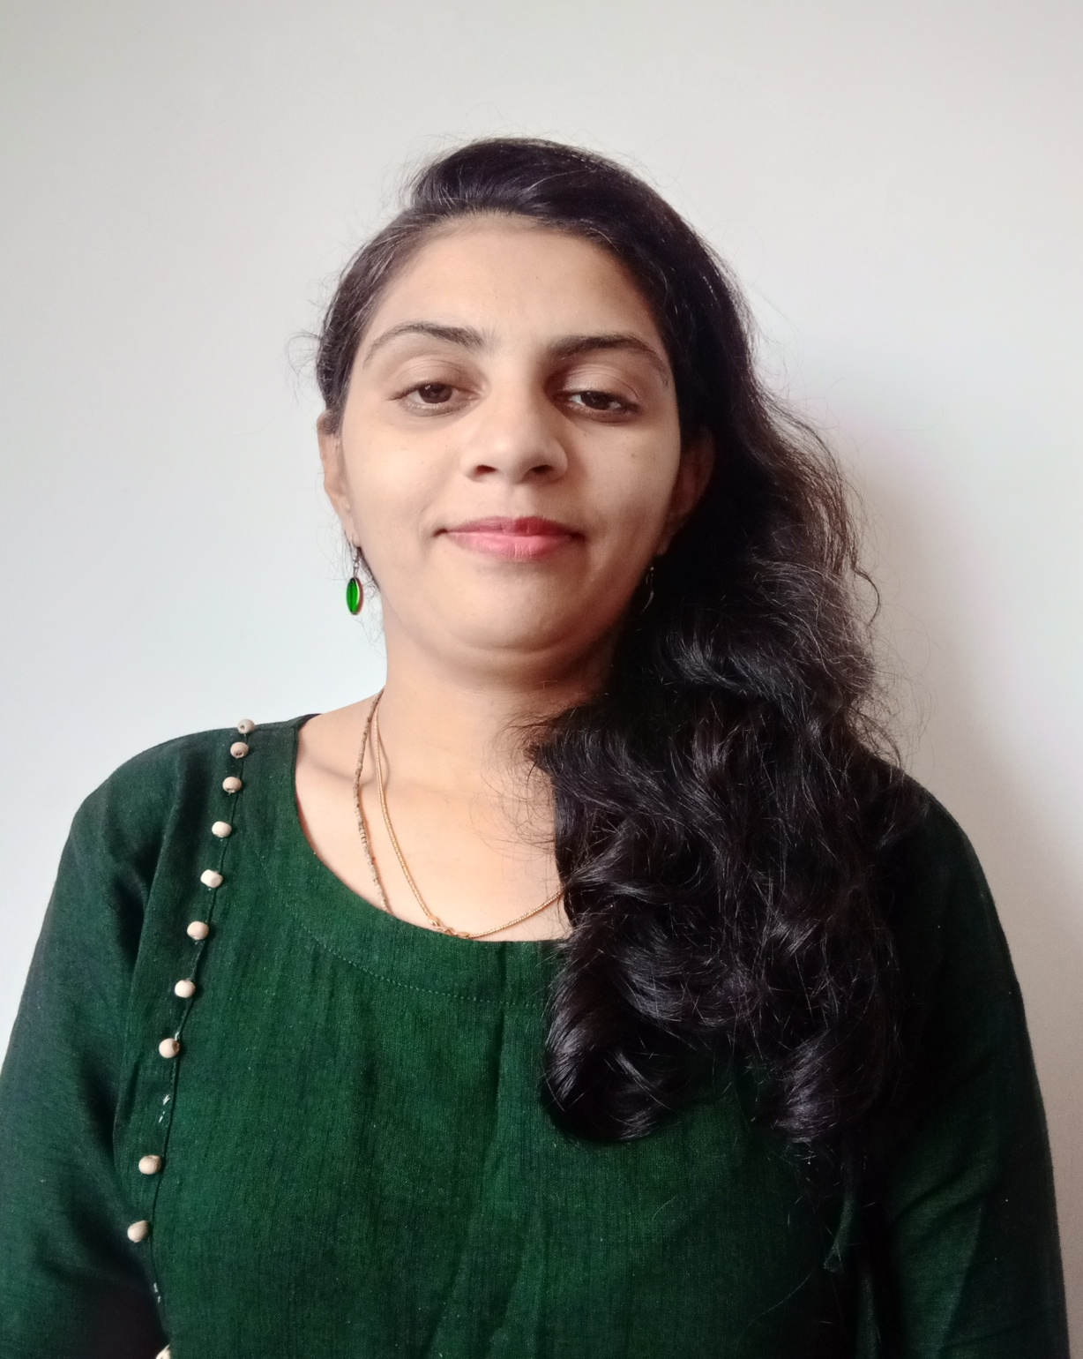
PARUL MADHANI- COUNCIL MEMBER
WICCI WELLNESS & WELLBEING COUNCIL GUJARAT
BIO :-
Name: Parul Madhani
Email:parulmadhani17@gmail.com
Qualification: B.Com+ Interior Decoration + Yoga trainer
Work Experience: Nagpur special Dry snacks and Making South Indian food as order

Slide 17
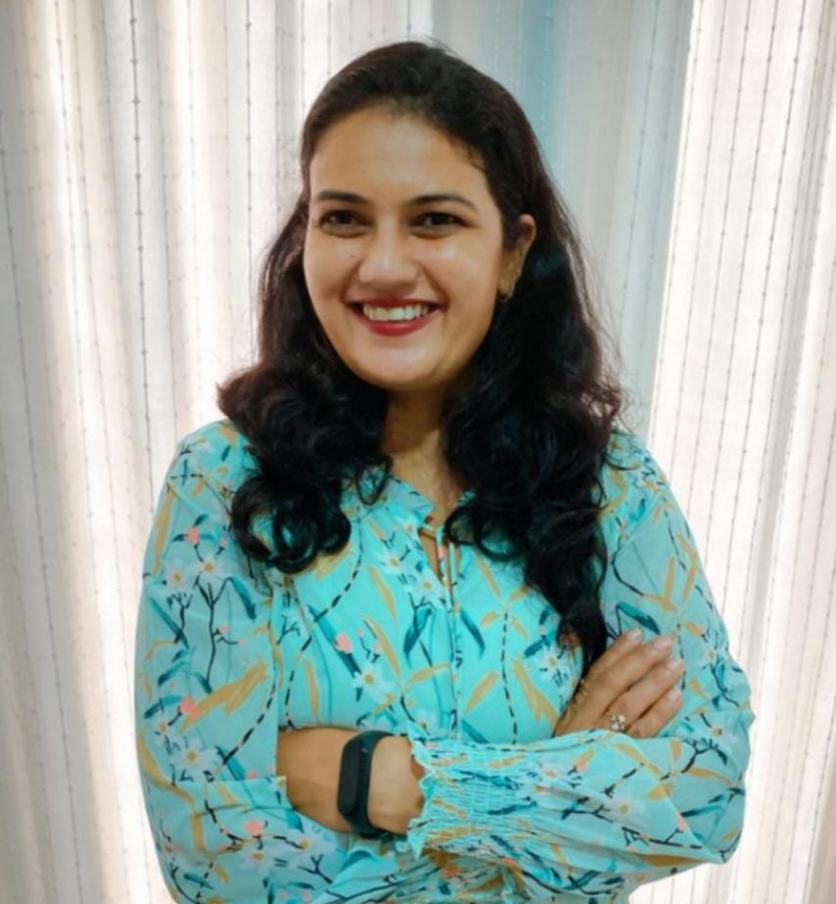
NEHA UPADHYAY- COUNCIL MEMBER
WICCI WELLNESS & WELLBEING COUNCIL GUJARAT
BIO :-
Neha Upadhyay
Email: coolnehu81@gmail.com
Qualification: B. Com
Work Experience: More than 15 years in various industries, Wellness Coach

Slide 18
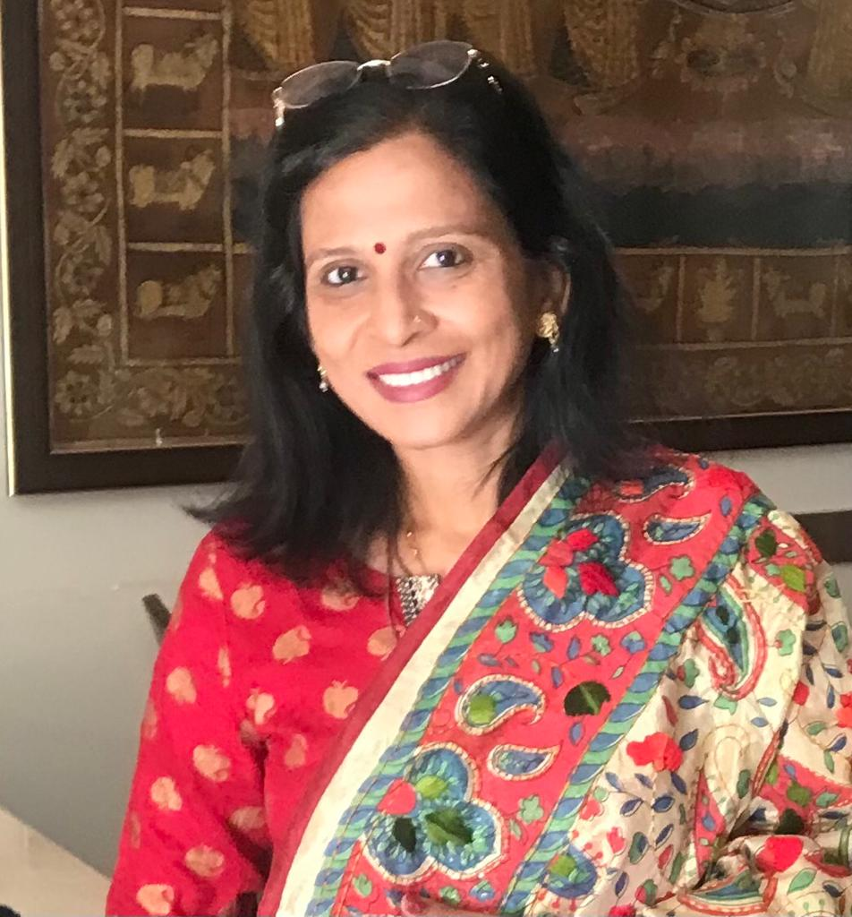
DHRUTI VALA- COUNCIL MEMBER
WICCI WELLNESS & WELLBEING COUNCIL GUJARAT
BIO :-
Name: Dhruti Vala
Email: dhrutivala2518@gmail.com
Qualification: Fashion designer
Work Experience: Firm name is Mama's skincare Herbal products, Skin and Hair related products started 7 months ago

Slide 19
AMISHA MADHANI- COUNCIL MEMBER
WICCI WELLNESS & WELLBEING COUNCIL GUJARAT
BIO :-
Name : Amisha Madhani
Email : amishamadhani123@gmail.com
Qualification: Student - 1st year B.com in advance management
Work Experience: Online Dance choreographer (taking online dance classes)

Slide 20
MONA MEHTA - COUNCIL MEMBER
WICCI WELLNESS & WELLBEING COUNCIL GUJARAT
BIO :-
Name: Mona Mehta
Email: nehalmona@gmail.com
Qualification: B.com, B.Ed. in Math & Sci
Work Experience: 20+ years experience in Event Management. Dance Choreography specialization in school annual functions & school events.

Slide 21
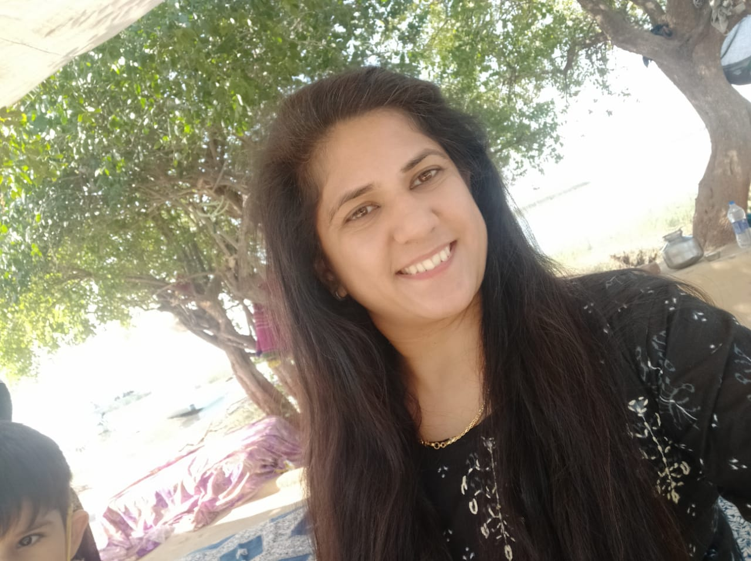
SHWETA JOSHI - COUNCIL MEMBER
WICCI WELLNESS & WELLBEING COUNCIL GUJARAT
BIO :-
Name: Shweta Joshi
Email: sj599133@gmail.com
Qualification: M.A English and B.ed
Work Experience: Working as Admin in future sports academy

Slide 22
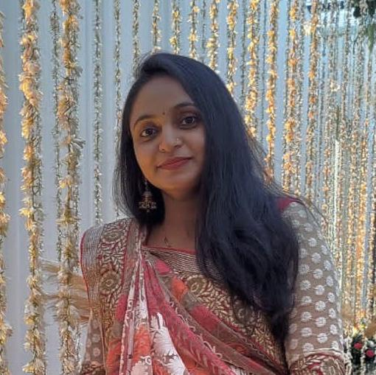
KRISHNA PATEL - COUNCIL MEMBER
WICCI WELLNESS & WELLBEING COUNCIL GUJARAT
BIO :-
Name: Krishna Patel
Email: patelkrishna1988@gmail.com
Qualification: B.com
Work Experience: Accountant

Slide 23
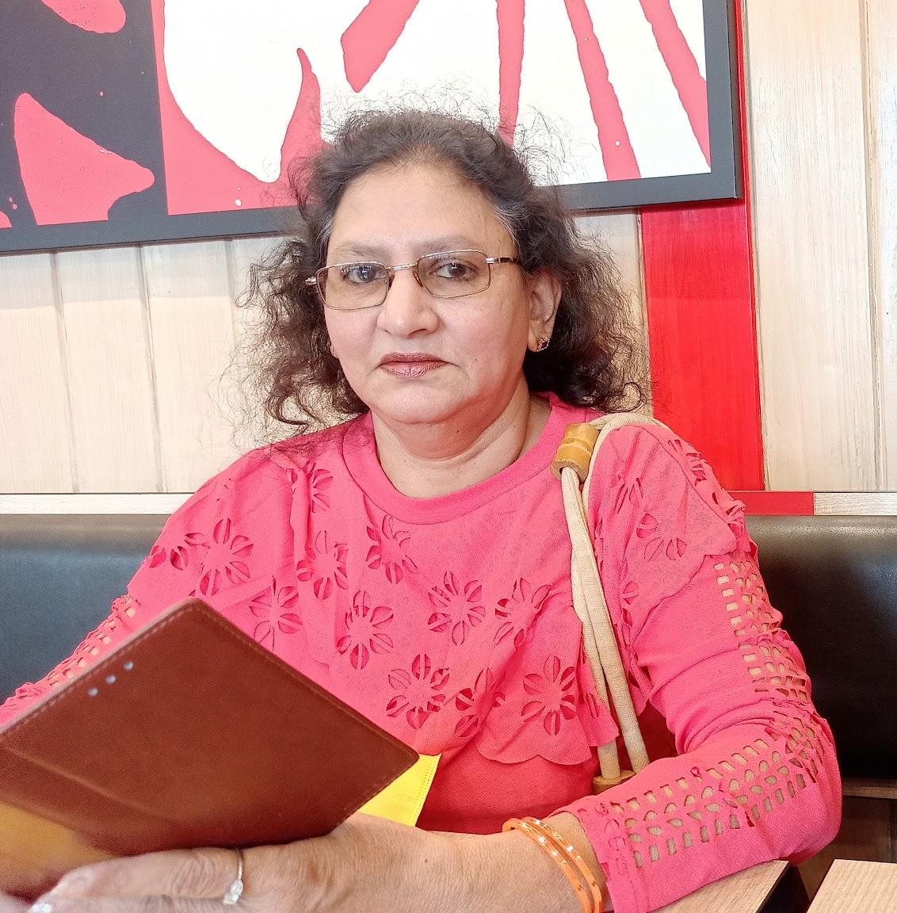
ANNA PEREIRA - COUNCIL MEMBER
WICCI WELLNESS & WELLBEING COUNCIL GUJARAT
BIO :-
Name: Anna Pereira
Email: anna041958@gmail.com
Qualification: Diploma in communication
Work Experience: Teaching, administration,
Personality Development trainer, Communication

Slide 24
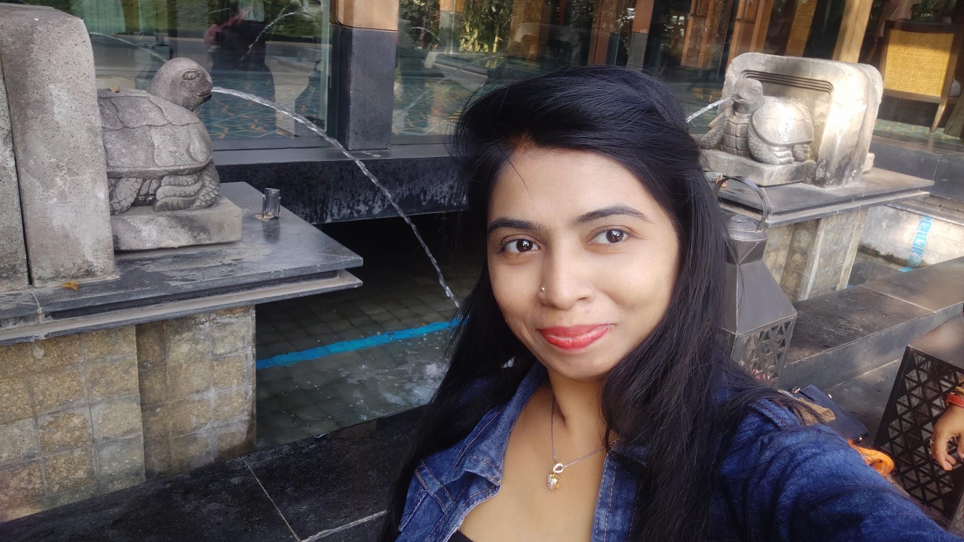
HIRAL CHAUHAN - COUNCIL MEMBER
WICCI WELLNESS & WELLBEING COUNCIL GUJARAT
BIO :-
Name: Hiral Chauhan
Email: hiral.tc.chauhan@gmail.com
Qualification: B.A, B.Ed
Work Experience: Firm name - Prahit Enterprise House hold products Business

Slide 25
REENA KALAL- COUNCIL MEMBER
WICCI WELLNESS & WELLBEING COUNCIL GUJARAT
BIO :-
Name: Reena Kalal
Email reenadkalal1983@gmail.com
Qualification: B. Com
Work experience : 15 years & Wellness Coach

Slide 26
DR SWAATI MHATRE- COUNCIL MEMBER
WICCI WELLNESS & WELLBEING COUNCIL GUJARAT
BIO :-
Name : Dr Swaati Mhatre
Email: swaatimhatre@ymail.com
Qualification: BAMS (Ayurveda and Panchkarma practitioner and also Access consciousness bar practitioner )
Work experienced : 15 years

Slide 27
SUPPORTED BY
WICCI is supported by the massive global networks of ALL Ladies League (ALL), Women Economic Forum (WEF), and SHEconomy.
ALL is a movement of ‘Sisters Beyond Borders.’
WEF is a platform for ‘Business Beyond Borders.’ SHEconomy is e-commerce for women worldwide in Goods & Services for ‘Commerce Beyond Borders’

Slide 28
COUNTRIES REPRESENTED
Albania, Angola, Armenia, Argentina, Australia, Azerbaijan, Bangladesh, Brazil, Burundi, Cameroon, Canada, Chad, China, Costa Rica, Croatia, Cyprus, Czech Republic, Colombia, Ecuador, Egypt, Ghana, Germany, Greece, Guatemala, Hong Kong, Hungary, India, Italy, Israel, Ireland, Japan, Kazakhstan, Kenya, Kyrgyzstan, Lesotho, Luxembourg, Malawi, Malaysia, Mexico, Moldova, Monaco, Montenegro, Morocco, Mozambique, Malta, Netherlands, Nigeria, Nepal, New Zealand, North Macedonia, Norway, Paraguay, Portugal, Peru, Puerto Rico, Philippines, Qatar, Romania, Russia, Rwanda, Serbia, Singapore, Slovenia, Spain, South Africa, South Korea, Suriname, Sweden, Switzerland, Syria, Tunisia, Turkey, Uganda, Ukraine, UK, Uruguay, Venezuela, Vietnam, Virgin Islands (US), UAE, USA, Uzbekistan, Zimbabwe.

Slide 29
WOMEN'S INDIAN CHAMBER OF COMMERCE ANDINDUSTRY

